Slide 1
Food Resources and associated problems
Environmental Science: Unit 1
Dr Vinayak V. Pathak
Department of Chemistry
Manav rachna University Faridabad

Slide 2
Introduction
Globally India is the third largest producer of cereals.
India occupies first position in milk production.
India is the third largest producer of fish and second in inland fisheries production.
About 11 million people are directly/ partially involve in the fisheries sector.
India ranks first in respect of cattle's and buffalos , second in goat, third in sheep and seventh in poultry.

Slide 3
Estimated production of major crops during 2020-2021
Items | Estimated production
Food Grains | 144.52 million tonnes
Rice | 102.36 Million tonnes
Nutri/ Coarse cereals | 32.84 million tonnes
Maize | 19.88 million tonnes
Pulses | 9.31 million tonnes
Oilseed | 25.73 million tonnes
Ground nut | 9.54 million tonnes
Soyabean | 13.58 billion tonnes
Cotton | 37.12 million bales (170 g of each)
Jute | 9.66 million bales ( 180 kg of each)
Sugarcane | 399.83 million tonnes

Slide 4
What is Kharif and Rabi crop
Kharif
Kharif crop is sown at the beginning of first monsoon.
Harvesting season begins 3rd week of September to October.
Kharif crops require good rainfall.
Paddy, Maize, Jwar, Bajra, Cotton, Soybean.
Rabi
Rabi crops are known as winter crops.
They are grown in October or November.
These crop require frequent irrigation.
Wheat, Barley, Pulses etc.

Slide 5
Green Revolution
Green revolution refers to the adaptation of modern farming practices ( high yielding seeds, tractors, fertilizers etc.) during the period of 1951 to 1960.
Mexico is called the birthplace and burial grond of the Green revolution.
Dr M.S. Swaminathan played lead role in Green revolution of India.
As a result of Green Revolution rice productivity increased from 2 tonnes (1960s) per hectare to 6 tonnes/ hectare ( mid 1990).

Slide 6
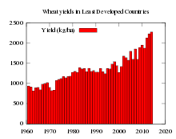

Slide 7
Crop productivity and food security
Growth rate of population in India is higher than the food grains production.
India ranks 67th in Global hunger index among 87 countries of worst food security status.
Food security is becoming the most critical issue of the development agenda in India.
To meet the demand of increasing population we need about 1/4th billion tonnes of grain/ year. Which can be achieved either by cultivation on more land or increasing production efficiency.

Slide 8
Overgrazing
Overgrazing occurs when plants are exposed to intensive grazing for extended periods of time, or without sufficient recovery periods. It can be caused by either livestock in poorly managed agricultural applications.
Overgrazing is the primary cause of desertification.
Overgrazing affects water quality and hydrology.
Solution involves proper management of livestock, land use management, sustainable agriculture etc.

Slide 9
Problems due to chemical fertilizers and pesticides
Fertilizers are intensively used to increase the crop production.
Pesticide is any substance or mixture of substances intended for preventing, destroying, repelling or mitigating any pest.
Massive use of inorganic fertilizers world-wide is associated with the accumulation of contaminants, e.g. arsenic (As), cadmium (Cd), fluorine (F), lead (Pb) and mercury (Hg) in agricultural soils.
In the USA, according to a survey of 51 major river basins and aquifer systems by the US Geological Survey, pesticides were detected 97% of the time in samples from stream water in agricultural areas.

Slide 10
Pesticide contamination has been found in Ganga River basin.
DDT (DichloroDiphenylTrichloroethane): Organochlorine pesticide, insoluble in water and soluble in organic solvent. Persistant in natur.
Endosulfan : Organochlorine insecticide, Acute toxic, potential for bioaccumulation.
Lindane: organochlorine, volatile in nature, potential to bioaccumulate.
Aldrin: Organochlorine, it is banned in most countries, persistant organic pollutants.
Dieldrin: chlorinated hydrocarbon, toxic in chronic exposure to many animals.
Malathion: Organophosphate, low human toxicity but induces lack of attention in children.
Parathion: Organophosphate compound, it disrupts nervous system.

Slide 11
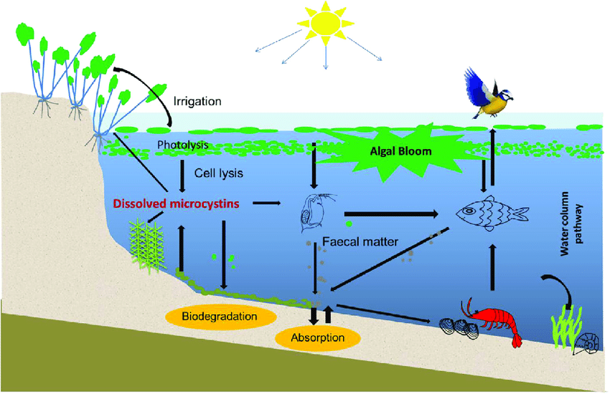
Bioaccumulation
Bioaccumulation refers to gradual increase of pesticide, chemical substance in an organism.
Bioaccumulation occurs when an organism absorbs a substance at a rate faster than that at which the substance is lost or eliminated by catabolism and excretion.

Slide 12
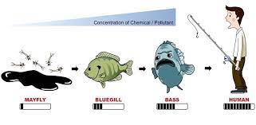
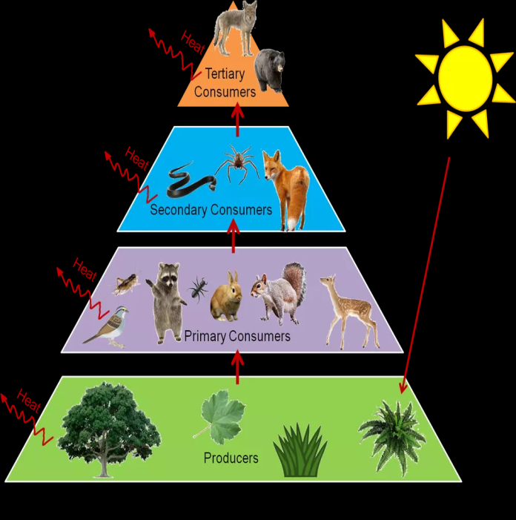
Biomagnification
The process by which a compound (such as a pollutant or pesticide) increases its concentration in the tissues of organisms as it travels up the food chain.

Slide 13
Sustainable Agriculture
A landscape approach: By fostering biodiversity and providing habitat for pollinators and other beneficial wildlife, such as birds, bats, and bees, uncultivated areas can boost farm productivity and reduce costs.
Crop diversity and rotation.
Cover crops: Some farmers grow plants known as cover crops to protect and build their soil during the off-season, or for livestock grazing or forage. Commonly planted cover crops include hairy vetch, annual ryegrass, and crimson clover.
Integrated farming
Drip irrigation

